Slide 1
Operation dad
Ben dunbar, Justin Hynes-Bruell, and bill wisheart

Slide 2
Outline
Introduction
Solution Approach
Inputs/Outputs
Conceptual Understanding
Experimental Results
Conclusion

Slide 3
Introduction to direction audio detection
Real time system that utilizes 2 microphones mounted on a wall to analyze sound waves and determine in which direction the sound originated from
Goal: Learn how to handle and compare two audio inputs while implementing skills gained from previous labs
Application: A security camera with a limited field of view could turn towards a source of sound

Slide 4
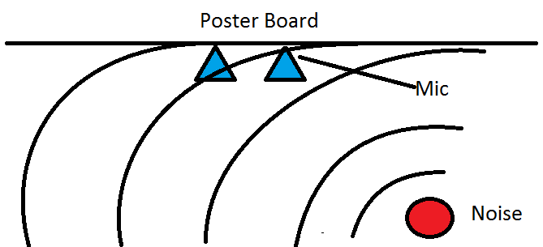
Solution Approach - Inputs
2 mics mounted to a PCB
Fixed distance apart
0.0327279 m

Slide 5
Solution approach – ProcessinG RX DATA
Pushed samples onto a queue to get a window of data on the audio signal.
Once the window was full it would start moving via push and pop functions.
The window was a queue class with a left and a right queue
The class provided a function to return the result of a convolution on the members.
for(sampleNr=0;sampleNr < samplesInChunk;sampleNr++) {
pThis->left[pThis->position] = ((unsigned int)pChunk->u16_buff[sampleNr]) << 24;
pThis->right[pThis->position] = 0x00FF & (((unsigned int)pChunk->u16_buff[sampleNr]) << 16);
pThis->position += 1;
}

Slide 6
Solution approach – Processing Corr
This slide will be about taking the two arrays and convolving them to determine to determine the Phase Shift

Slide 7
Solution Approach – angle computation
//Get the phase difference from the convolve queue.
int samplesDelayed = convolveQueue_getSampleCountPhaseDiff(&pThis->convQueue);
//Angle equation:
//Our calculations will work when the two signals are between -4 and 4 samples
//different in terms of phase offset.
double ratio = (double) SPEED_SOUND * (samplesDelayed/SAMPLING_FREQUENCY)/MIC_DISTANCE;
double sourceAngle = asin(ratio);
//source angle to degrees
sourceAngle = sourceAngle * 180.0/PI;
//This calculated angle is the angle away from the line that is equidistant from each
//microphone, which is 90 degrees in our analysis.
int angle = 90 + (int) sourceAngle;
//Give tenths of degrees
angle = angle * 10;

Slide 8
Solution approach - Outputs
This slide will go over how the Angle and Distance output was passed to the output task and displayed.

Slide 9
Experimental Results
Gathered test files from the mic setup.
Analyzed test files in MatLab to determine viablilty of convolution approach.
Output completed, tested once the new workspace was available.
Processing was tested to make sure that given the phase difference, the angle calculation was correct.
In the end the mics could pick up audio, the processor could analyze the signal, and the LEDs and OLED screen could successfully return the calculated result.

Slide 10
Conclusion
Difficulties faced
Tasks ended up blocking each other during debug periods
Successfully gathering left and right data from the RX chunks
Understanding correlations using the convolve method
Solutions created
Raised the priority of the output task and ensured it would go into the suspend state so the processing task could run.
Gathered left samples with a 24 bit shift on the pChunk->u16_buff
Gathered right samples with a 16 bit shift and then a 0x00FF mask on the data.
Placed samples into separate arrays
Wrote a function to perform a convolution on two arrays of unsigned int to determine the phase shift between the two arrays

